Slide 1

HAMLET REVITALIZATION
“Crossroads Project”
LaFayette Hotel

Slide 2
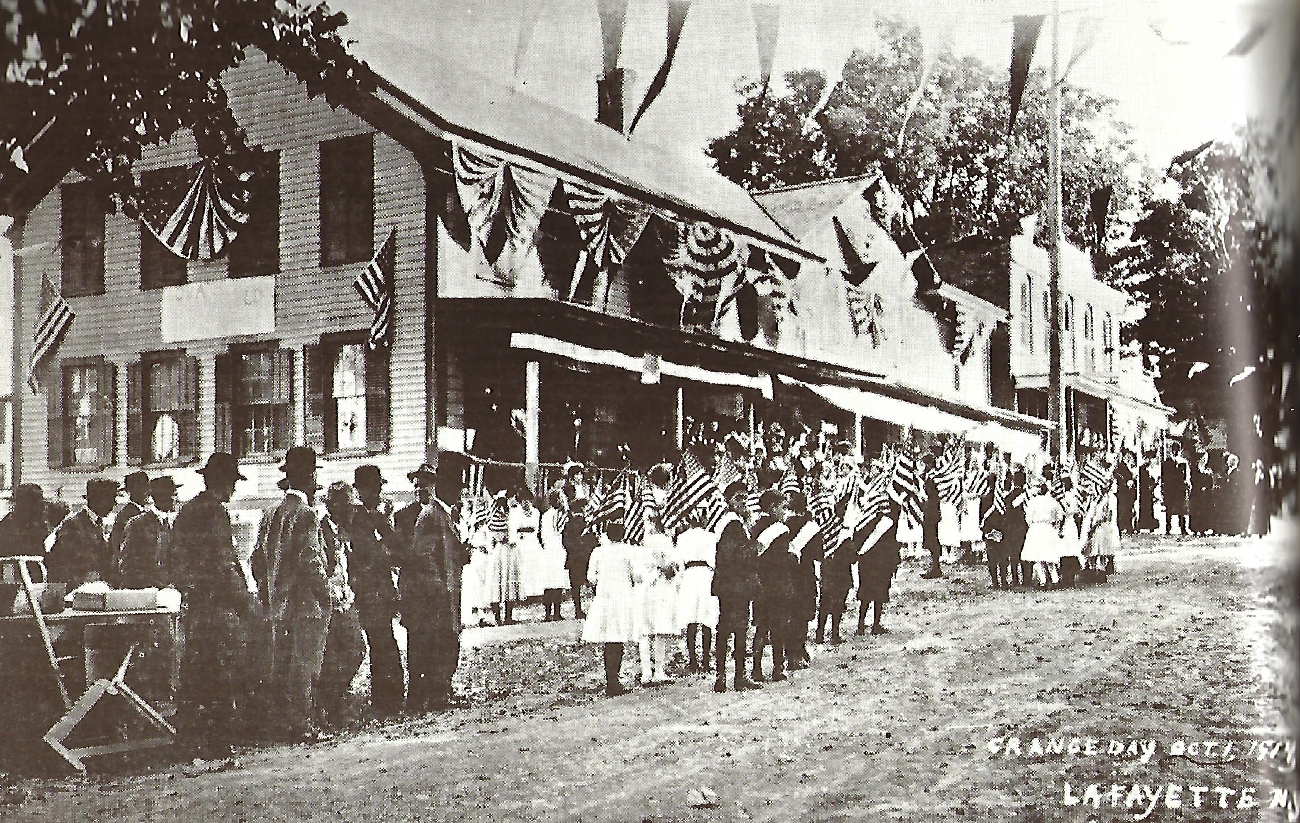


Slide 3

LaFayette Hotel & “Millette” parcel status
28 Feb. 2022
Town of LaFayette closed on the parcel
10 Mar. 2022
Town of LaFayette will close on Millette Parcel

Slide 4
constraints
Municipal Owned Property:
  IDA or LDC?
Neighbors do not want the hotel property to be used as apartments
Local diner prefers no competition
Site remediation for a spill: April 15
Unknown status of the well(s)
No septic field

Slide 5
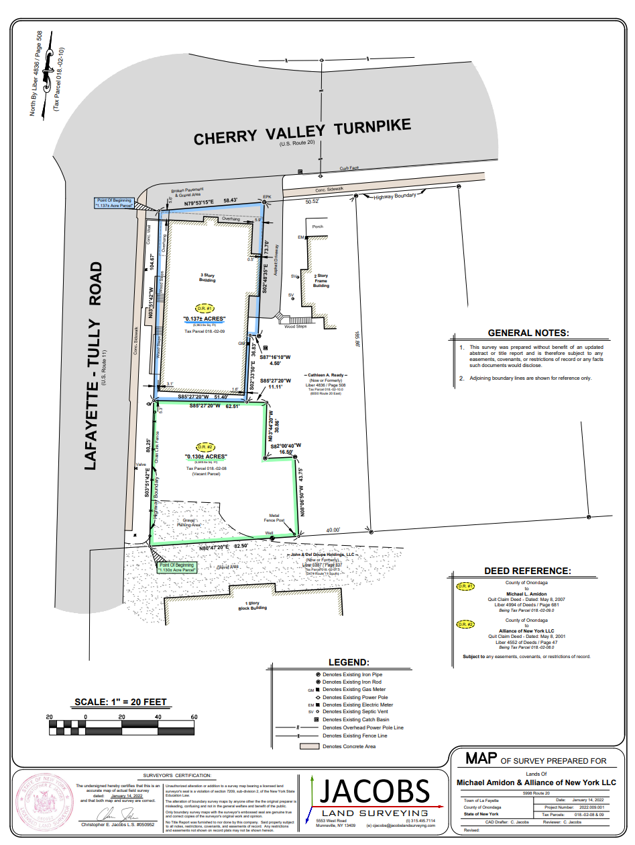

Slide 6



Current town investment
$77K for the purchase of both properties
$18K for the completion of Phase I and II inspections
Funding Source: 2021 Town of LaFayette ARPA Funding

Slide 7




Confirmed future funding
$500K: Onondaga ARPA Grant: in progress
Current project obligation:
$50k for site remediation
Consulting Services and Engineering Services: TBD

Slide 8
Initial crossroads focus
To rehabilitate the LaFayette Hotel as a Public Parcel to:
  Make the site a destination
  Encourage public and private use
  Seek a partner(s) with a similar vision

Slide 9


A destination
A Crossroads “Stop & Visit”: Historical Route 20 Association
Business Incubators
Non-profit Seasonal Space: food, agritourism business start-ups
Appealing store fronts
Comfortable public spaces

Slide 10
Public and private use
Find the “Balance” to allow both uses
  IDA or LDC or ?

Slide 11



Partners with “our” vision
Local Collaboration
Those with an Imagination
Those who can build on Historical Tradition

Slide 12
Determine the course
Demolish the building and begin over”
  “tear it down, build a retainer wall and plant a Christmas tree”
  Or
Repurpose the building and the parcel with a long-term vision?

Slide 13
We all have skin in the game!
“We must work on behalf of the Town and its Residents:
  How to pay without taxation?
How to benefit the Town Commercially and Aesthetically?
  Resident patience is exhausted
This “one project” will be a catalyst for more!

Slide 14
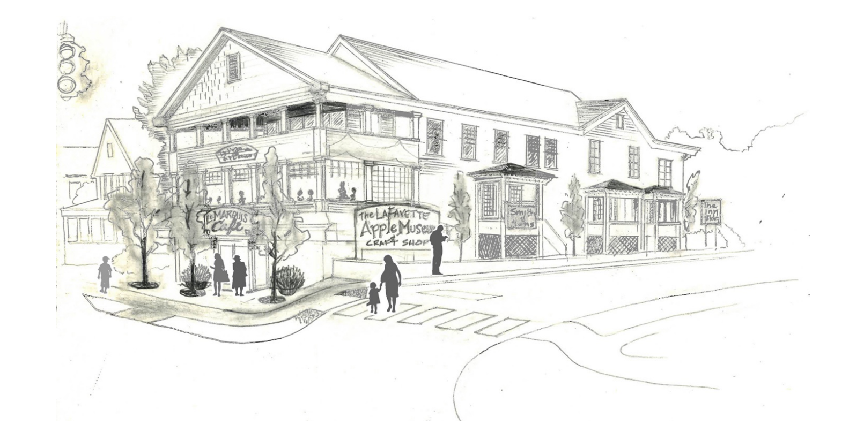

Slide 15
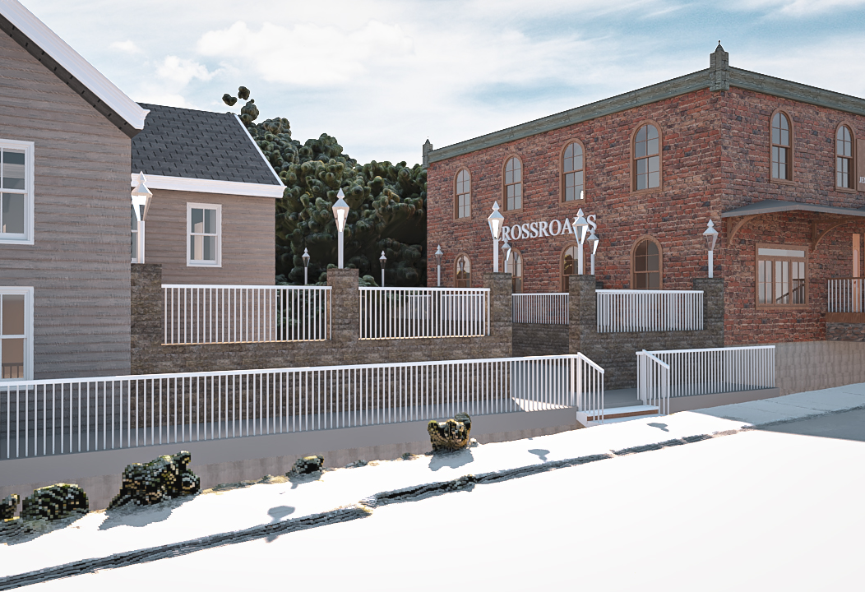
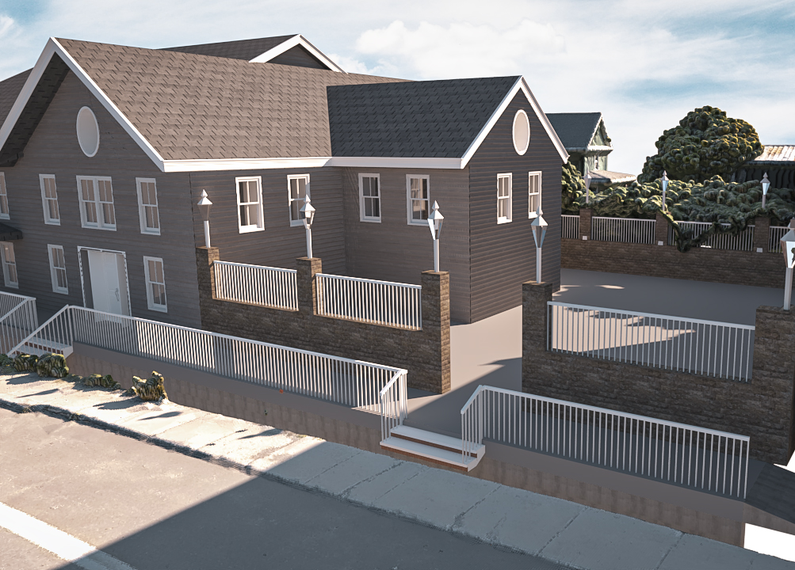

Determine the course

Slide 16

Let’s go to work!
Definition of Town Community Development Committee Expanded*:
Experts, local and distant, who will partner on the Crossroads Project.
  Must be introduced and approved by the Town Board

